Slide 1
Accounting: Purpose and Use
Financial Statements, Matching, and Estimation

Slide 2
Our Class Thesis: The purpose of accounting
Profit measurement (to estimate firm performance)
Profit used as a basis for decision making
  How to use internal resources to make sales (i.e. manage)
  Whether to fund a firm (i.e. investors – external decisions)
  Both decisions try to increase firm value LR profit stream
  Within an ethical and sustainable context (including CSR)
Main concepts: Accrual (matching) cf. cash flow & cost behavior (Contribution Margin Income statement)

Slide 3
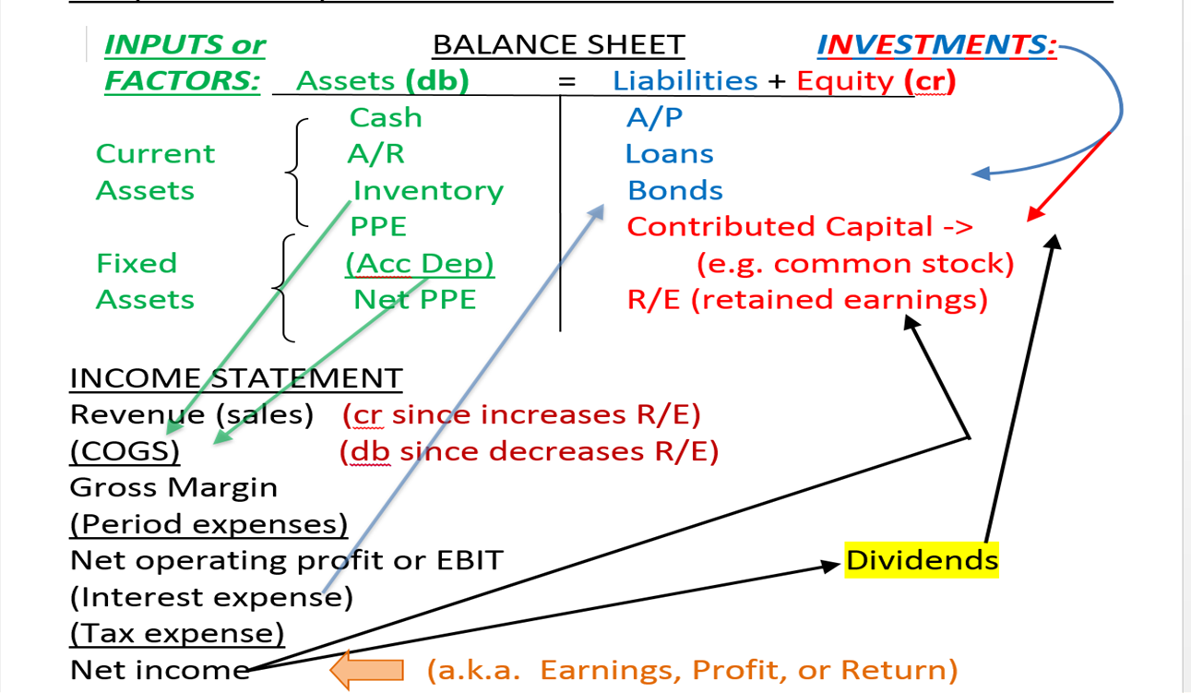
Accrual Financial Statements: Cash?
PQ
(VQ)
CM
(F)
Profit

Slide 4
Accrual statements: MATCHING
Accrual statements tell the story of the firm (business model)
  (IS):Revenue model (idea for sales), but at what cost?
  (BS):What assets and operations are necessary?
  (BS):How are they financed?
  (SCF):s there sufficient cash to operate? Is it sustainable?
Matching (alignment of revenue with its cost) is on the INCOME STATEMENT (a.k.a. Profit & Loss or P&L)
BALANCE SHEET balances due to financing of assets
  Assets are used to make sales NOT MATCHING
STATEMENT OF CASH FLOWS is to monitor sources & uses

Slide 5
Accounting Conceptual Framework (FASB)
Starts with why: our thesis – provide information to decision makers
Desired characteristics of this information:
  Relevant – predictive, confirmatory, timely
  Reliable – complete, neutral, reproducible
  Consistent – from period to period
  Comparable – from firm to firm
Elements: assets, liabilities, equities, revenues, expenses, gains, losses, investment by owners, distributions to owners, comprehensive income

Slide 6
Assumptions and Constraints:
Assumptions:
  Going Concern – stays in business
  Periodicity – regular end of period
  Constant Monetary Unit – inflation can be ignored
  Economic Entity – the boundaries of the company are discernable
Constraints:
  Materiality – would it matter to a reasonable investor? Choice of method
  Conservatism – low estimates of revenue/gains, high estimates of costs/losses
  Cost-Benefit Tradeoff – if the method is not worth the information, don’t
  Industry Practices – if other similar firms do it one way, be comparable

Slide 7
Conceptual Framework (FASB) continued
Principles:
  Revenue Recognition – at the time of the sales (not when collected) TRIGGERS→
  Expense Matching – alignment of specific sales with their costs for profit measurement
  Historical Cost of assets for depreciation (i.e. matching)
  Full Disclosure – of all relevant information (e.g. notes to the financials)

Slide 8
Estimations
Matching helps measure performance
  Revenue recognition triggers it (at the time of sale)
  Cost measurement issues (cost benefit tradeoff, accuracy?)
  Judgement
    Method (e.g. depreciation)
    Inputs (accuracy?)
  Manipulation
    Performance pay or appearance
    Cost of capital (investments)
Cash helps “check” accrual (in addition to being necessary to operate)
  Profits should turn into cash at a regular rate (operating CF)
  Cash has other sources and uses (investment, financing CFs)

Slide 9
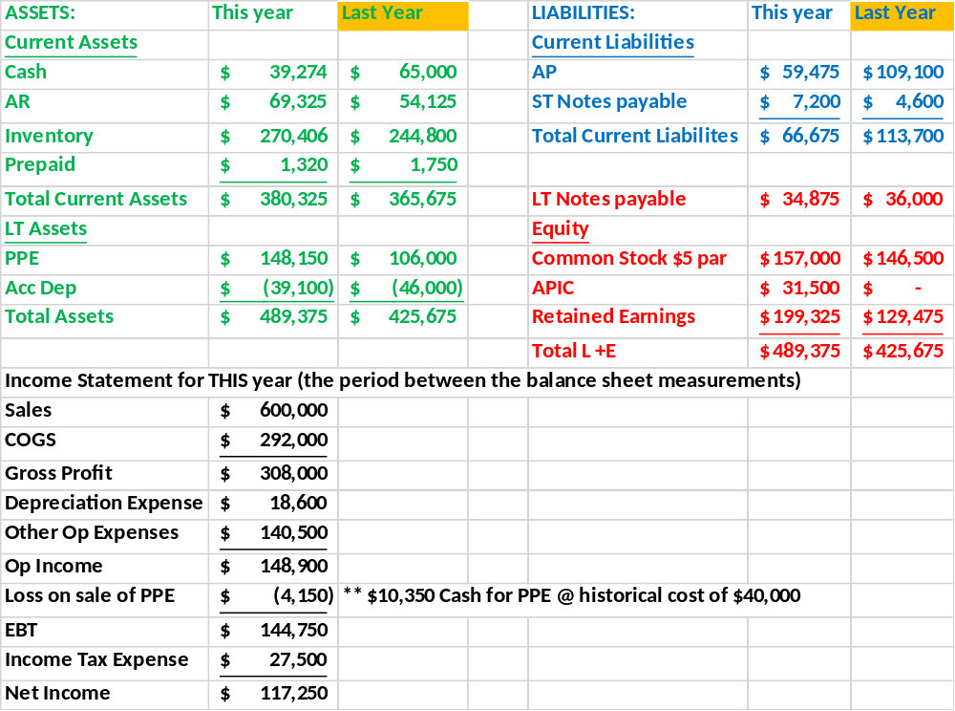
Comparative Balance Sheet –across P&L time
Balance Sheet accounts are
Permanent accounts that carry over
their balances from year to year.
Income Statement accounts are
Temporary accounts that are closed
out to Retained Earnings on the
Balance Sheet at the end of each
fiscal year. The new year
starts with zero balances in each
account.

Slide 10
Accrual Financial Statements: Cash?
PQ
(VQ)
CM
(F)
Profit

